Slide 1
Languages of acts 2
Outpouring of the Holy Ghost
Notes:
NOTE:
To change the image on this slide, select the picture and delete it. Then click the Pictures icon in the placeholder to insert your own image.

Slide 2
1. Parthians
Language, Olden and Present

Slide 3
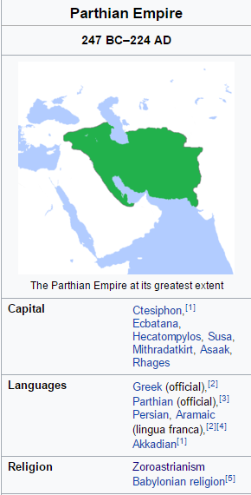
Parthians (Acts 2:10) 247 BC to 224 AD
Language
Parthian
Origin Country
Ancient Iran & Iraq
Present world
Iran
Iraq
Parthian/Arsacid Empire
Turkmenistan
Afghanistan
Syria
Derived from Aramic
Turkmen – Official language of Turkmenistan (then Parthian)

Slide 4
Parthian Language script & Sound

Slide 5
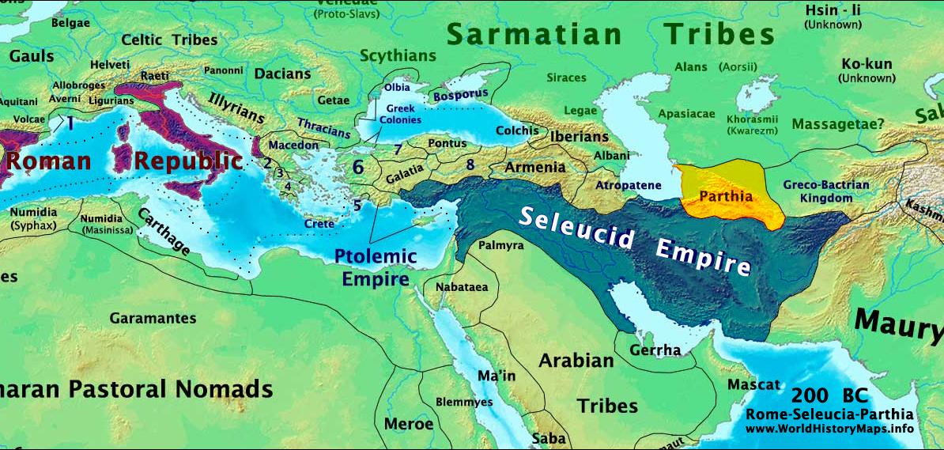
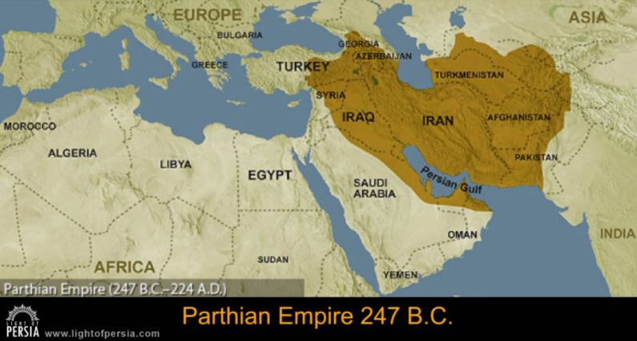
History Map of Parthia and Modern countries

Slide 6
2. medians
Language, Olden and Present

Slide 7
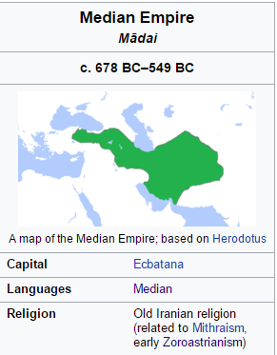
Medians (Acts 2:10) 678 BC to 549 BC
Language
Median
Origin Country
Present world
Iran
Median
Medean / Medic
The Median language (also Medean or Medic) was the language of the Medes.[2] It is an Old Iranian language and classified as belonging to the Northwestern Iranian subfamily

Slide 8
Median Language script & Sound
No Scripts are found in history

Slide 9
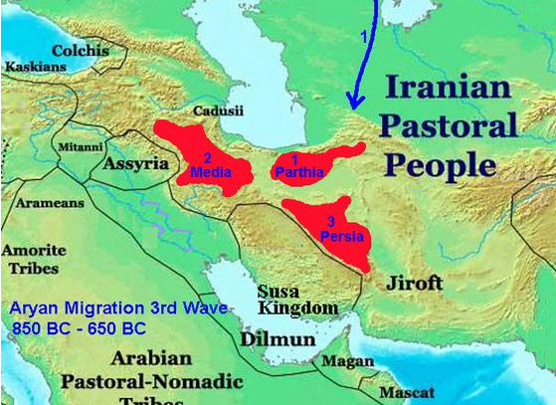
Biblical History Map of Media

Slide 10
3. Elamites
Language, Olden and Present

Slide 11
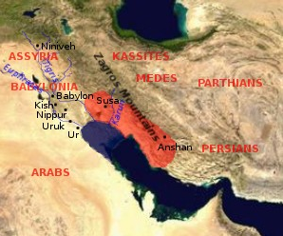
Elamites (Acts 2:10) 2800 to 550 BC
Language
Elamite
Origin Country
Present world
Iran
Elam
Elamite is an extinct language spoken by the ancient Elamites. Elamite was a language used in present-day south-western Iran from 2800 to 550 BC

Slide 12
Ancient Elam in the modern era

Slide 13
4. Mesopotamia
Language, Olden and Present

Slide 14
Mesopotamia (Acts 2:10) 2800 to 550 BC
Language
Sumerian, Akkadian (Babylonian + Assyrian), Amorite, and - later - Aramaic
Origin Country
Present world
most of Iraq plus Kuwait, the eastern parts of Syria, Southeastern Turkey, and regions along the Turkish-Syrian and Iran–Iraq borders.
Mesopotamia
[land] between rivers [Tigris–Euphrates river]

Slide 15
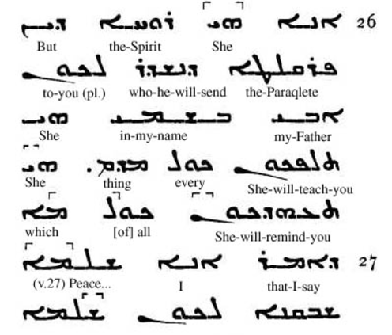
Aramic – script and sound (Lord’s prayer)

Slide 16
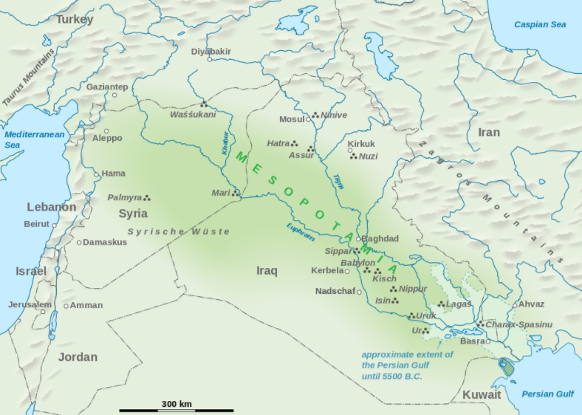
Mesopotamia in the modern era countries

Slide 17
5. Judea
Language, Olden and Present

Slide 18
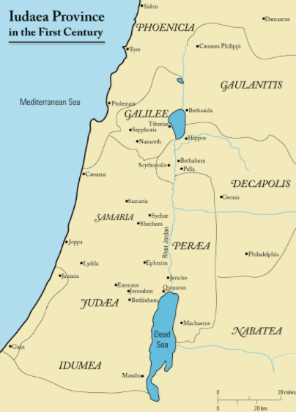
Judea (Acts 2:10) 934 until 586 BCE
Language
Semitic Aramaic and Hebrew languages as well as Greek, with Aramaic being the predominant language
Origin Country
Present world
modern-day name of the mountainous southern part of Canaan-Israel
Judea

Slide 19
Aramic – script and sound (Lord’s prayer)

Slide 20
6. Capadoccia
Language, Olden and Present

Slide 21
Capadoccia (Acts 2:10) 934 until 586 BCE
Language
Semitic Aramaic and Hebrew languages as well as Greek, with Aramaic being the predominant language
Origin Country
Present world
modern-day name of the mountainous southern part of Canaan-Israel
Judea

Slide 22
Aramic – script and sound (Lord’s prayer)

Slide 23
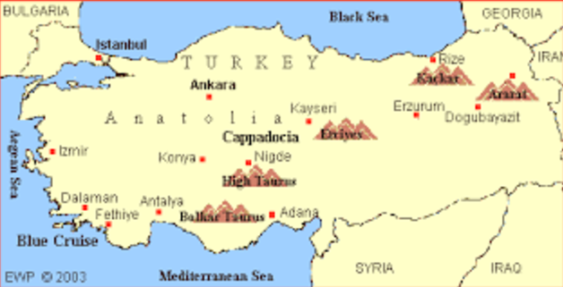
Old Cappadocia & Modern turkey

Slide 24
7. pontus
Language, Olden and Present

Slide 25
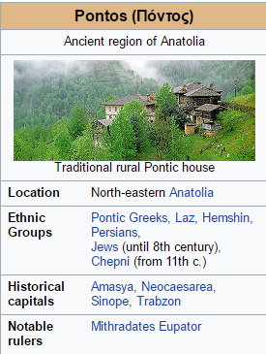
Pontus (Acts 2:10)
Language
Greek
Origin Country
Present world
Turkey
Pontus ( Anatolia)

Slide 26
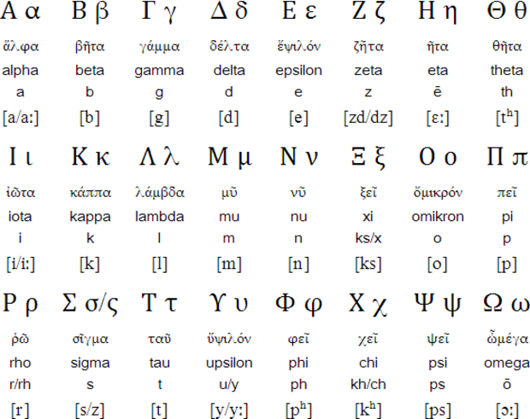
Greek – script and sound (Lord’s prayer)

Slide 27
8. Asia
More than 2000 languages spoken in Asia

Slide 28
9. Pamphylia
Language, Olden and Present

Slide 29
Pamphylia (Acts 2:10)
Language
Ancient Greek
Origin Country
Present world
Turkey
Pamphylia
Pamphylia was a former region in the south of Asia Minor, between Lycia and Cilicia, extending from the Mediterranean to Mount Taurus (modern-day Antalya province, Turkey)

Slide 30
10. Phrygia
Language, Olden and Present

Slide 31
Phrygia (Acts 2:10)
Language
Ancient Greek
Origin Country
Present world
Turkey
Pamphylia
Pamphylia was a former region in the south of Asia Minor, between Lycia and Cilicia, extending from the Mediterranean to Mount Taurus (modern-day Antalya province, Turkey)

Slide 32
11. egypt
Language, Olden and Present

Slide 33
Egypt (Acts 2:10)
Language
Arabic
Origin Country
Present world
Egypt
Egypt

Slide 34
12. creyen, Libiya
Language, Olden and Present

Slide 35
Libya (Acts 2:11)
Language
Arabic
Origin Country
Present world
Libya
Libya
Libya is a country in the Maghreb region of North Africa, bordered by the Mediterranean Sea to the north, Egypt to the east, Sudan to the southeast, Chad and Niger to the south and Algeria and Tunisia to the west

Slide 36
13. Crete
Language, Olden and Present

Slide 37
Crete (Acts 2:11)
Language
Indo-European Greek Attic–Ionic Demotic Greek Southern dialects Cretan Greek
Origin Country
Present world
Greece
Crete
Crete is the largest and most populous of the Greek islands

Slide 38
14. Arabs
Language, Olden and Present

Slide 39
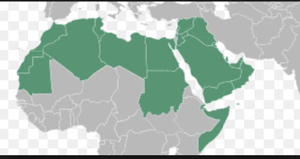
Arabs (Acts 2:11)
Language
Arabic
Origin Country
Present world
Saudi arabia, etc
Arab countries

Slide 40
15. Rome
Language, Olden and Present

Slide 41
Arabs (Acts 2:11)
Language
Roman
Origin Country
Present world
Rome
Romania

Slide 42
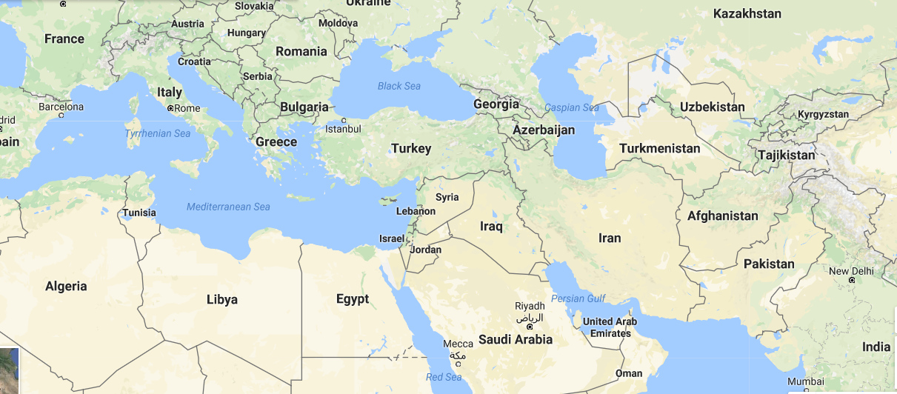
Modern world Map
Rome
Pontus
Parthia
Phrygia
Pamphylia
Cappadocia
Medes
Crete
Mesapatomia
Libya
Judea
Elamites
Arabia

